Slide 1
Case Study： War and Inventions — Medicine
This presentation material is based on the content of Military History from Multiple Perspective: Economy, Medicine, International Law and Others, the learning and teaching resources for History and corresponds to the History Curriculum Guide (Secondary 1-3)(2019) Topic 9: ‘International conflicts and crises in the 20th century (I) – the two world wars’.

Slide 2
Learning Objectives
Knowledge：Understand the contributions of medical inventions of the two world wars to humanity
Skill：Analyse the relationship between medical inventions of the two world wars and contemporary life
Attitude：Understand that war is cruel, and need to cherish peace; at the same time, appreciate human beings' affection for life as well as the wounded and the sick, and learn the perseverance of inventors/discoverers.

Slide 3
Brief introduction of Teaching Flow
Pre-Lesson task
Complete the pre-lesson worksheet and learn about medical inventions of the two world wars through self-directed learning. (Appendix A)
Classwork
Students report on their learning outcomes, understand the disaster brought by the two world wars and how medical inventions of the two world wars helped save the sick and the wounded. (Appendixes B-D)
Post Lesson Task
Students conduct extended activity on the discovery of penicillin and learn about the inventor's /discoverer's perseverance. (Appendix E)

Slide 4
Pre-Lesson Task
For details,
Please refer to Appendix A
Use the summary of Chapter 3: War and Medicine from Military History from Multiple Perspectives: Economy, Medicine, International Law and Others to arouse students’ learning motivation.
Teacher guides each group of students to complete the pre-lesson worksheet (Appendix A), developing their spirit of self-directed learning.
Through reading ‘Chapter 3: War and Medicine’ and collecting other information, students can understand the medical inventions of the two world wars, including:
Different medical inventions
Injuries that medical inventions are primarily dealing with
Main function of the medical inventions
Whether the medical inventions are still used in today's society

Slide 5
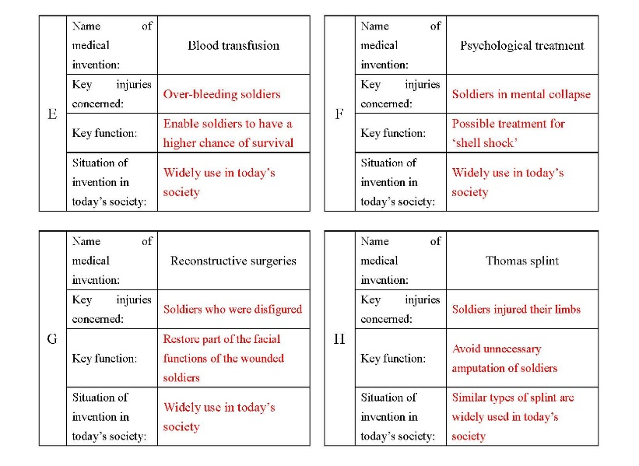
Introduction activity
For details,
Please refer to Appendix A
Students form different “Discussion groups” according to various medical inventions on the worksheet, with numbers assigned to each member. Different groups read relevant information and complete the questions.
Members with the same numbers among “Discussion groups” form “Expert groups”, and share their learning and jot down the main points.
After jotting down the main points from “Expert groups”, students return to their “Discussion groups” and report their learning with each other, so as to complete the “pre-lesson” worksheet.
Regarding the detailed teaching process of JIGSAW grouping, teachers can refer to the Learning and Teaching Resource Pack for Secondary History Curriculum—How to cater for learning diversity in History class developed by the Personal, Social and Humanities Education Section earlier https://www.edb.gov.hk/en/curriculum-development/kla/pshe/references-and-resources/history/cater_for_learning_diversity_in_hist_class.html

Slide 6
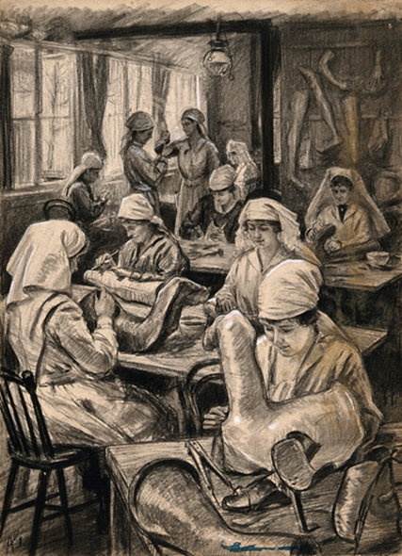
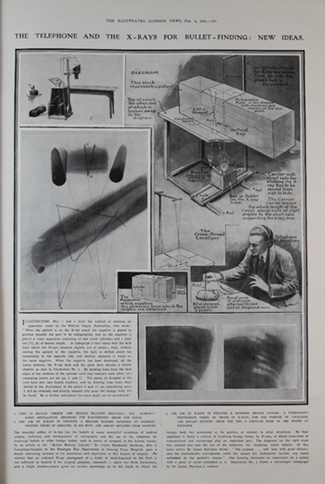
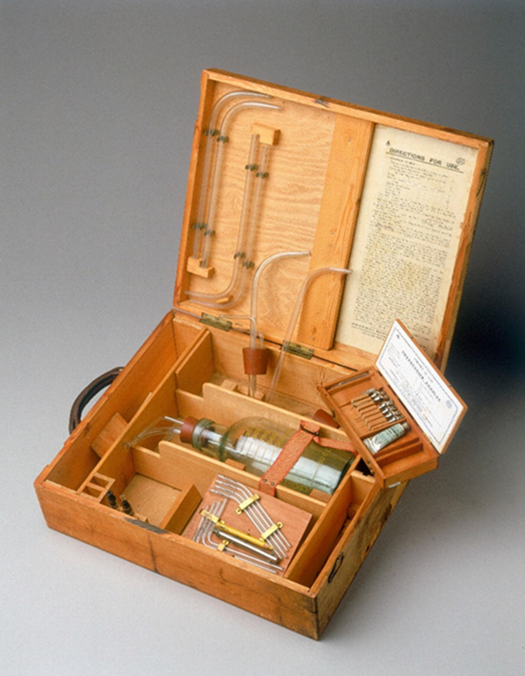
Introduction activity
Teacher should effectively use the illustrations in Military History from Multiple Perspectives: Economy, Medicine, International Law and Others in his/her explanation in order to help students understand related medical inventions.
Teacher can also collect more relevant information to help students understand related medical inventions.
The above pictures are taken from War and Medicine from Military History from Multiple Perspective: Economy, Medicine, International Law and Others.

Slide 7
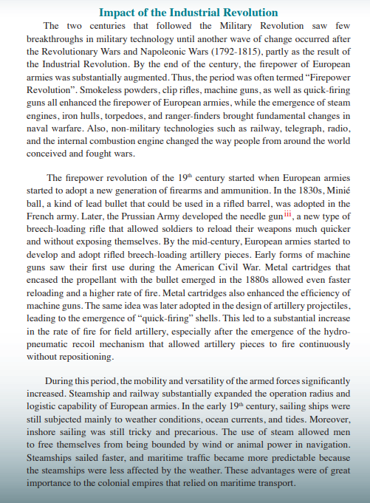
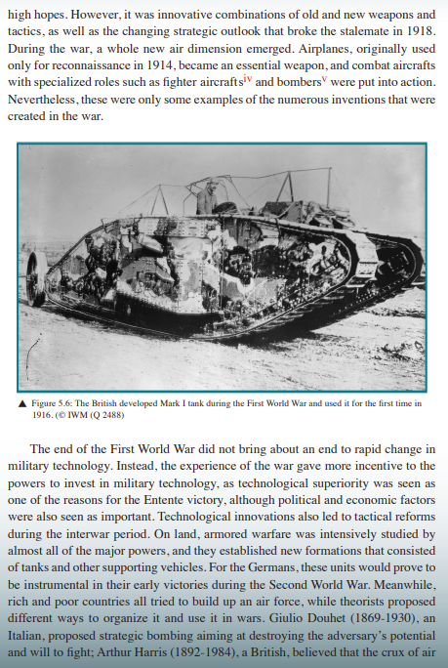
Activity one： War and harm
Teacher uses the content of ‘Chapter 5: War and Technological Innovation’ in Military History from Multiple Perspectives: Economy, Medicine, International Law and Others to help students understand how technological innovation makes weapons more lethal.
Teachers should emphasise to students that weapons are becoming more lethal and causing unprecedented harm to human beings. So peace must be cherished.

Slide 8
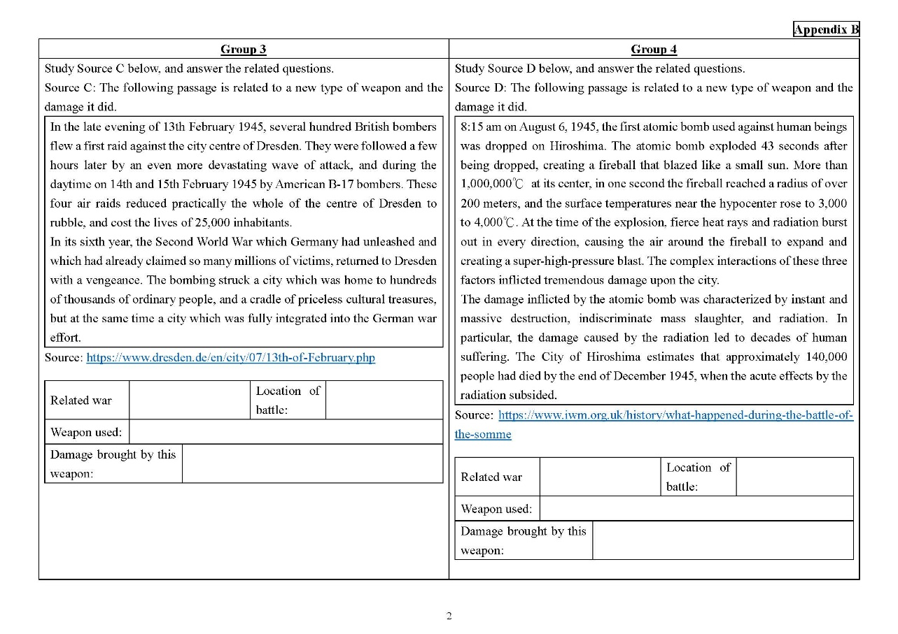
Activity One： War and harm
For details,
Please refer to Appendix B
Students are divided into four groups and each group completes the relevant questions after studying information about important battles/events of World War I or World War II (Appendix B).
Teachers can collect relevant historical information to help students understand how technological innovations cause harm on a larger scale, such as ：
toxic gas
machine guns
bombers
atomic bombs

Slide 9
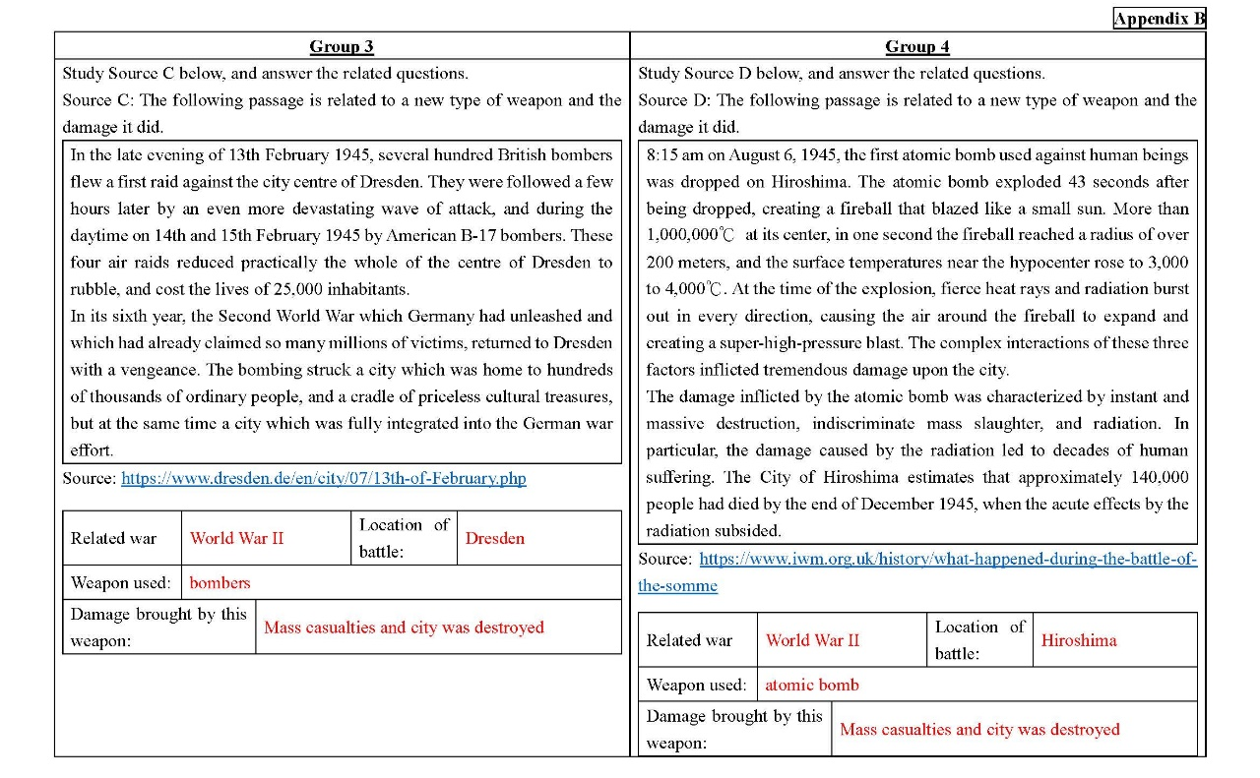
Activity One： War and harm
For details,
Please refer to Appendix B
Teachers can use the learning and teaching strategy of JIGSAW grouping, so that students can report to and learn from each other in the form of “Discussion group” and “Expert group” and complete the whole worksheet.
Regarding the process of JIGSAW grouping, teachers can refer to the fifth slide of this presentation materials, and the Learning and Teaching Resource Pack for Secondary History Curriculum—How to cater for learning diversity in History class developed by the Personal, Social and Humanities Education Section earlier
https://www.edb.gov.hk/en/curriculum-development/kla/pshe/references-and-resources/history/cater_for_learning_diversity_in_hist_class.html

Slide 10
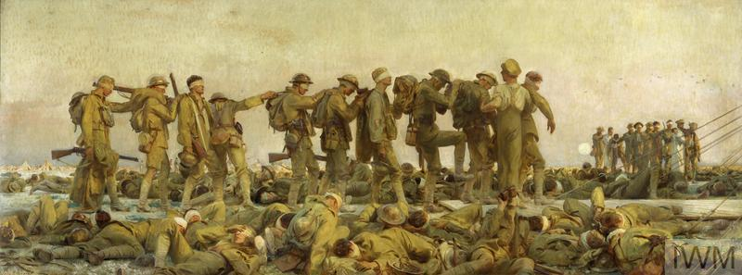
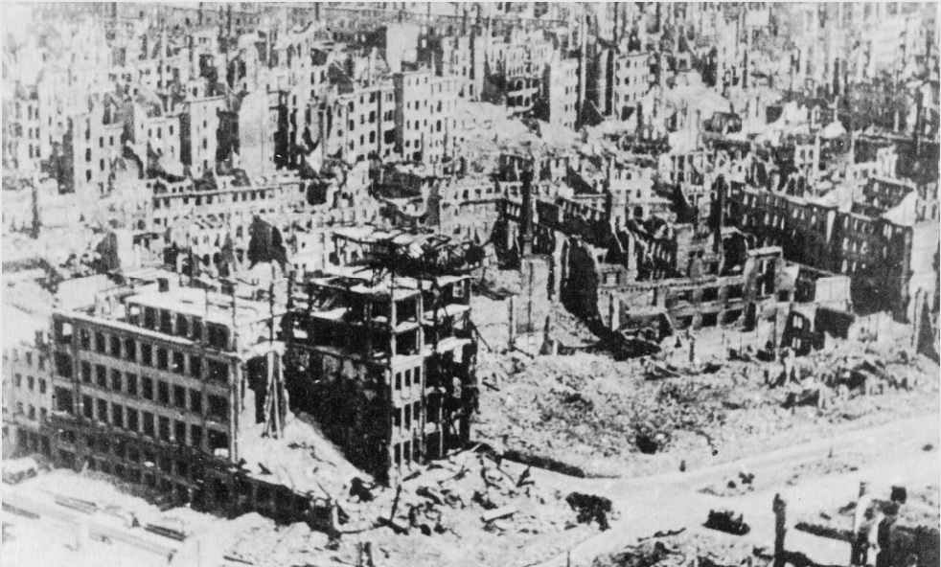
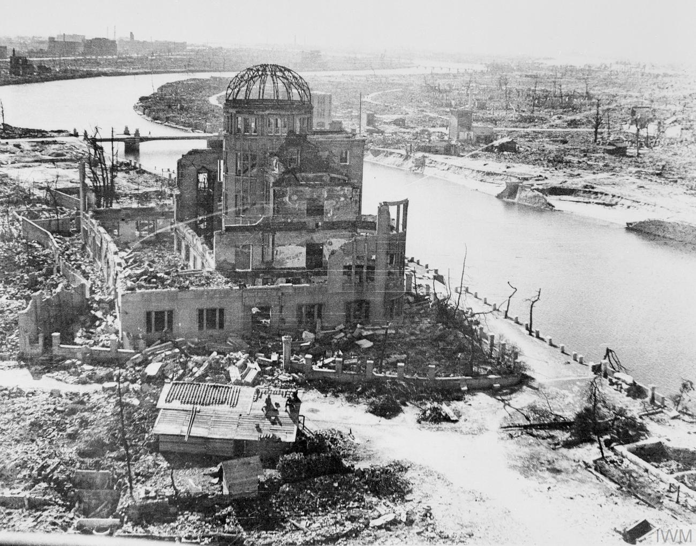
Activity One： War and harm
© IWM
(Art.IWM ART 1460) ▼
▲ © IWM Q 53
Teacher can also collect more relevant information to help students understand the harm caused by the two world wars.
Teacher should emphasise to students that war inventions, such as toxic gas, machine guns, bombers and atomic bombs, will bring heavy casualties, so peace must be cherished.
▲ © IWM HU 44924
© IWM MH 29427 ◥

Slide 11
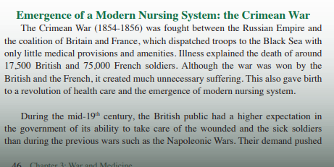
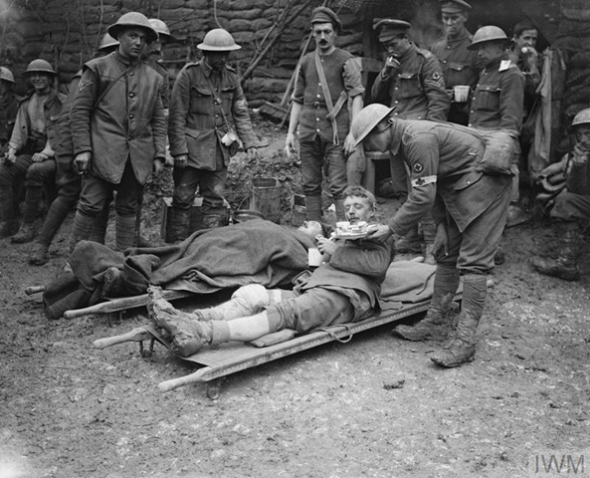
Activity two：war and medicine
Teacher uses the content of ‘Chapter 3: War and Medicine’ in Military History from Multiple Perspective: Economy, Medicine, International Law and Others to help students understand the importance of instant medical care on the battlefields.
Teacher can also collect more relevant information, such as the picture on the left, so that students can understand the medical work and needs on the battlefield so as to help them complete Activity 2 (Appendix C).
© IWM Q 4506◥

Slide 12
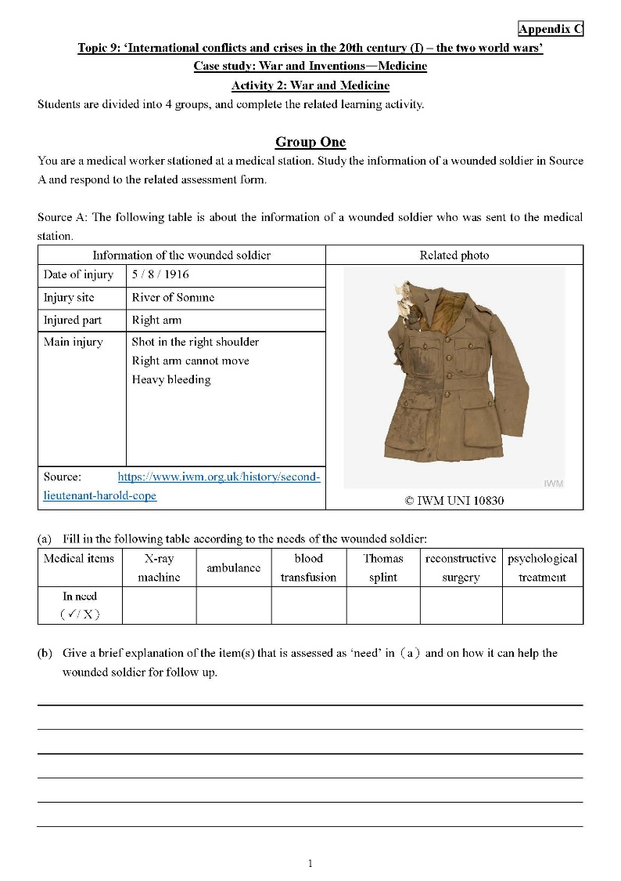
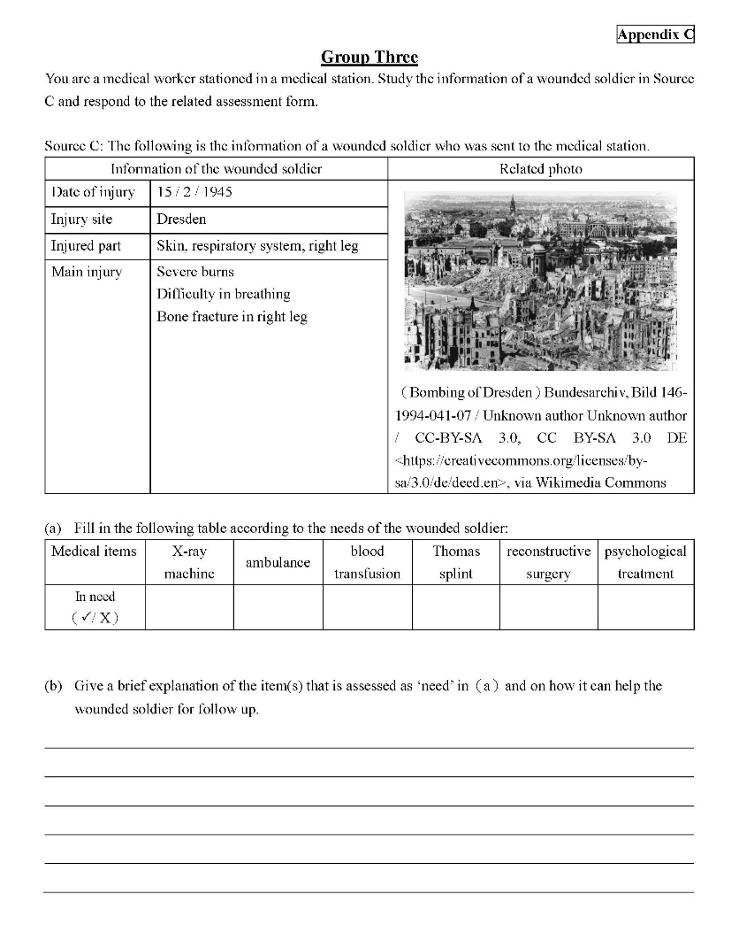
Activity two：war and medicine
For details,
Please refer to Appendix C
Teacher uses his/her professional knowledge to follow up the harm caused by four new military inventions (toxic gas, machine guns, bombers and atomic bombs) to human beings in Activity one (Appendix B).
Students are divided into four groups. Each group studies information of an injured person and infers whether and how the medical inventions can help the injured person in his recovery by using what have learnt in the ‘pre-lesson task’ and ‘introduction activity’.

Slide 13
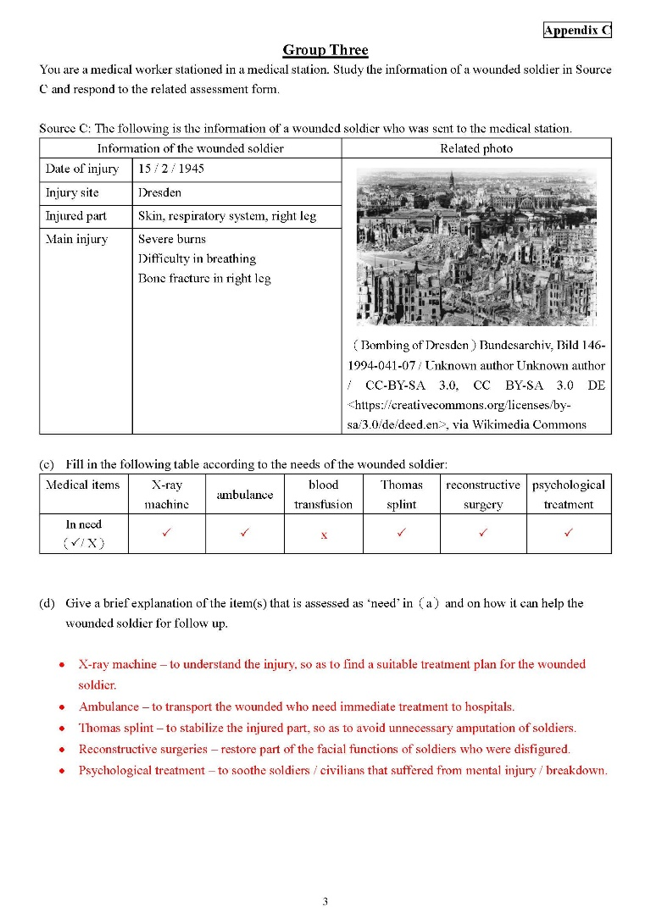
Activity two：war and medicine
For details,
Please refer to Appendix C
Teachers can use the learning and teaching strategy of JIGSAW grouping, so that students can report to and learn from each other in the form of “Discussion group” and “Expert group” and complete the whole worksheet.
Regarding the process of JIGSAW grouping, teachers can refer to the fifth slide of this presentation materials, and the Learning and Teaching Resource Pack for Secondary History Curriculum—How to cater for learning diversity in History class developed by the Personal, Social and Humanities Education Section earlier https://www.edb.gov.hk/en/curriculum-development/kla/pshe/references-and-resources/history/cater_for_learning_diversity_in_hist_class.html
Teacher should emphasise and let students understand clearly that no matter how advanced and well-developed medicine is, wars still cause great casualties of soldiers and civilians.

Slide 14
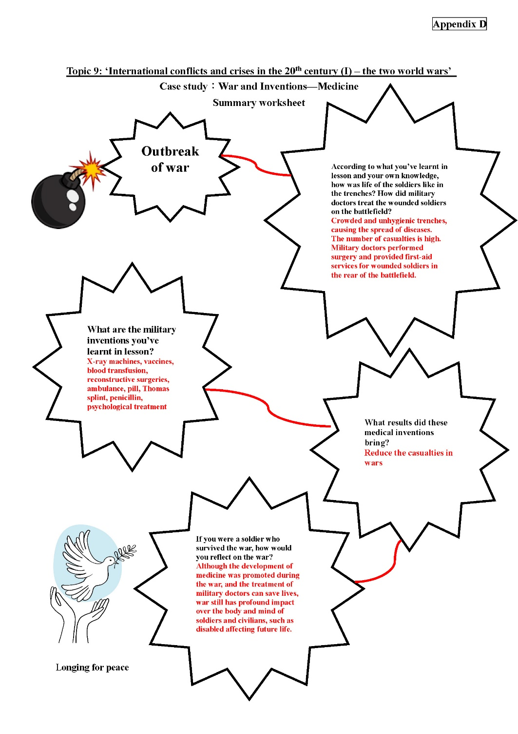
Summary activity
For details,
Please refer to Appendix D
Teacher can use the summary worksheet (Appendix D) to let students think about how wartime doctors and scientists developed different medical technologies and drugs with perseverance to reduce casualties and contributed to humanitarian relief under challenging circumstances.
Teacher should also explain that although people had improved medical technology during the wars, the trauma caused by wars cannot be entirely relieved by medical technology, thereby bringing out the importance of cherishing peace.

Slide 15
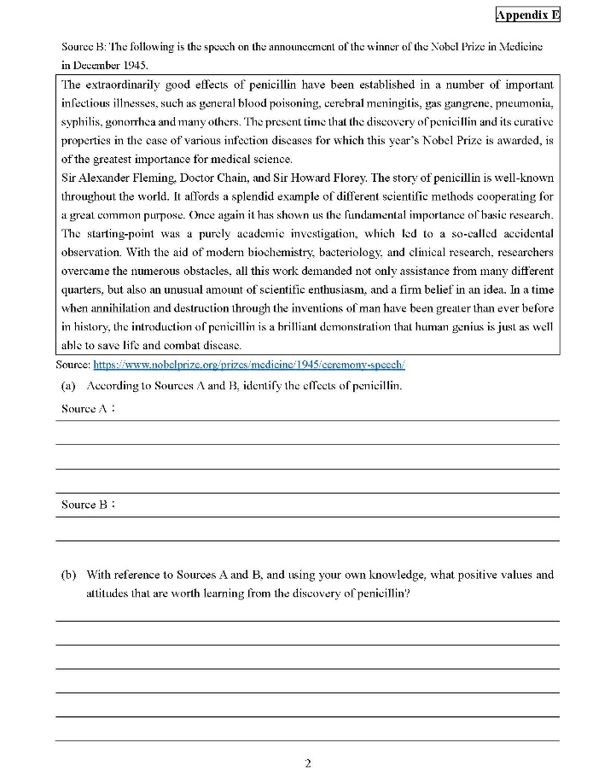
Extended activity： the discovery of Penicillin
For details,
Please refer to Appendix E
Students learn about the discovery of penicillin and its effects through the reading materials (Appendix E).
Students learn about the positive values ​​of perseverance and hardworking from the inventor/discoverer.
Teacher should emphasise to students the importance of cherishing peace.

